Slide 1
Cash Flow Estimation and Risk Analysis
CHAPTER 11
© 2020 Cengage Learning. All Rights Reserved. May not be copied, scanned, or duplicated, in whole or in part, except for use as permitted in a license distributed with a certain product or service or otherwise on a password-protected website for classroom use.

Slide 2
Topics
Estimating cash flows:
Relevant cash flows
Working capital treatment
Risk analysis:
Sensitivity analysis
Scenario analysis
Simulation analysis
Real options

Slide 3
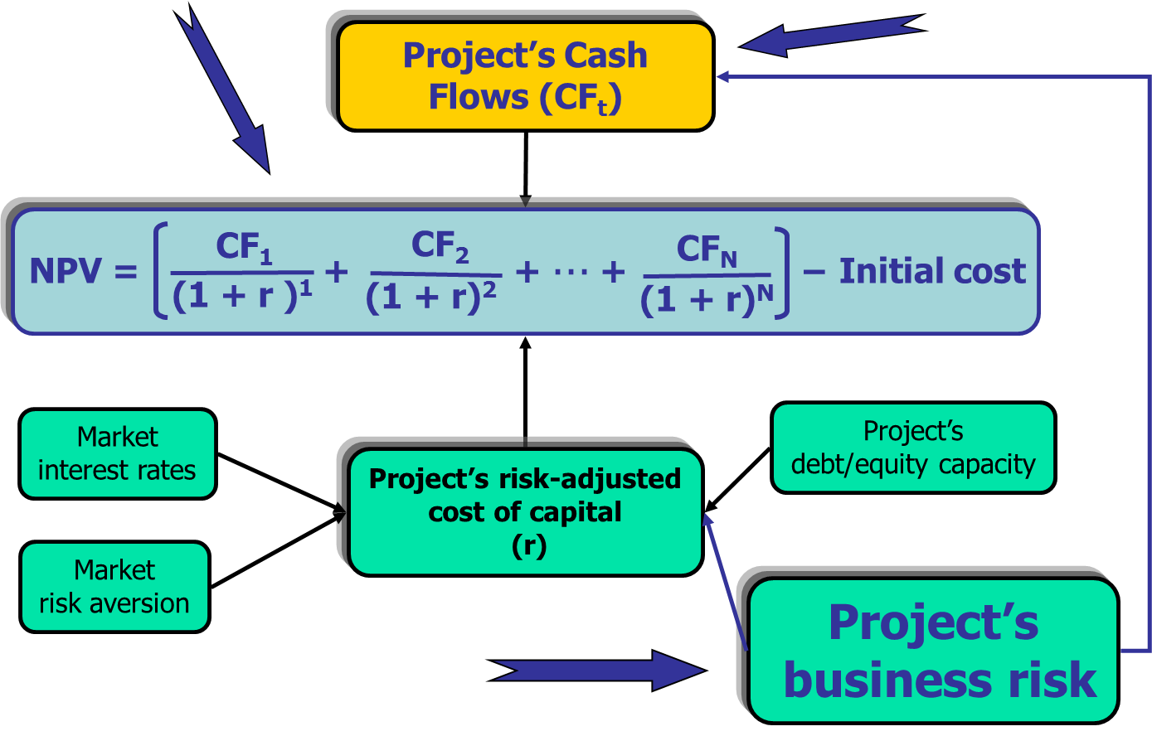
The Big Picture: Project Risk Analysis

Slide 4
Proposed Project Data (1 of 2)
$200,000 cost + $10,000 shipping + $30,000 installation.
Economic life = 4 years.
Salvage value = $25,000.
MACRS 3-year class.

Slide 5
Proposed Project Data (2 of 2)
Annual unit sales = 1,000.
Unit sales price = $200.
Unit costs = $100.
Net working capital:
NWC_{t} = 12%(Sales_{t+1})
Tax rate = 25%.
Project cost of capital = 10%.

Slide 6
Incremental Cash Flow for a Project
Project’s incremental cash flow is:
Corporate cash flow with the project
Minus
Corporate cash flow without the project.

Slide 7
Treatment of Financing Costs
Should you subtract interest expense or dividends when calculating CF?
NO.
We discount project cash flows with a cost of capital that is the rate of return required by all investors (not just debtholders or stockholders), and so we should discount the total amount of cash flow available to all investors.
They are part of the costs of capital. If we subtracted them from cash flows, we would be double counting capital costs.

Slide 8
Sunk Costs
Suppose $100,000 had been spent last year to improve the production line site. Should this cost be included in the analysis?
NO. This is a sunk cost. Focus on incremental investment and operating cash flows.

Slide 9
Incremental Costs
Suppose the plant space could be leased out for $25,000 a year. Would this affect the analysis?
Yes. Accepting the project means we will not receive the $25,000. This is an opportunity cost and it should be charged to the project.
A.T. opportunity cost = $25,000 (1 – T) = $15,000 annual cost.

Slide 10
Externalities
If the new product line would decrease sales of the firm’s other products by $50,000 per year, would this affect the analysis?
Yes. The effects on the other projects’ CFs are “externalities.”
Net CF loss per year on other lines would be a cost to this project.
Externalities will be positive if new projects are complements to existing assets, negative if substitutes.

Slide 11
What is an asset’s depreciable basis?
Basis | = | Cost
 | + | Shipping
 | + | Installation
 |  | $240,000

Slide 12
Annual Depreciation Expense
Basis = | $240,000
Year | Depr. Rate | Depr. = Basis (Rate) | Remaining book value
Year 1 | 0.3333 | $79,992 | $160,008
Year 2 | 0.4445 | $106,680 | $53,328
Year 3 | 0.1481 | $35,544 | $17,784
Year 4 | 0.0741 | $17,784 | $0

Slide 13
Annual Sales and Costs
 | Year 1 | Year 2 | Year 3 | Year 4
Units | 1,000 | 1,000 | 1,000 | 1,000
Unit price | $200 | $206 | $212.18 | $218.55
Unit cost | $100 | $103 | $106.09 | $109.27
Sales | $200,000 | $206,000 | $212,180 | $218,545
Costs | $100,000 | $103,000 | $106,090 | $109,273

Slide 14
Why is it important to include inflation when estimating cash flows?
Nominal r > real r. The cost of capital, r, includes a premium for inflation.
Nominal CF > real CF. This is because nominal cash flows incorporate inflation.
If you discount real CF with the higher nominal r, then your NPV estimate is too low.

Slide 15
Inflation (Continued)
Nominal CF should be discounted with nominal r, and real CF should be discounted with real r.
It is more realistic to find the nominal CF (i.e., increase cash flow estimates with inflation) than it is to reduce the nominal r to a real r.

Slide 16
Net Operating Profit After Taxes (NOPAT): Years 1 and 2
 | Year 1 | Year 2
Sales | $200,000 | $206,000
Costs | $100,000 | $103,000
Depreciation | $79,992 | $106,680
EBIT | $20,008 | -$3,680
Taxes (25%) | $5,002 | -$920
NOPAT | $15,006 | -$2,760

Slide 17
Net Operating Profit After Taxes (NOPAT): Years 3 and 4
 | Year 3 | Year 4
Sales | $212,180.0 | $218,545.4
−Costs | $106,090.0 | $109,272.7
−Depreciation | $35,544.0 | $17,784.0
EBIT | $70,546.0 | $91,488.7
−Taxes (25%) | $17,636.5 | $22,872.2
NOPAT | $52,909.5 | $68,616.5

Slide 18
Operating Cash Flows = NOPAT + Depreciation
 | NOPAT | + Depr. = | Op. CF
Year 1 | $15,006.0 | $79,992.0 | $94,998.0
Year 2 | -$2,760.0 | $106,680.0 | $103,920.0
Year 3 | $52,909.5 | $35,544.0 | $88,453.5
Year 4 | $68,616.5 | $17,784.0 | $86,400.5

Slide 19
Cash Flows Due to Investments in Net Working Capital (NWC)
 | Sales | NWC (% of sales) | CF Due to Investment in NWC
Year 0 |  | $24,000 | -$24,000
Year 1 | $200,000 | $24,720 | -$720
Year 2 | $206,000 | $25,462 | -$742
Year 3 | $212,180 | $26,225 | -$763
Year 4 | $218,545 | $0 | $26,225

Slide 20
After-Tax Salvage Cash Flow at t = 4
(1) Salvage value | $25,000
(2) Book value | $0
(3) Gain or loss: (1) − (2) | $25,000
(4)Tax on gain or loss | $6,250
(5) After-tax salvage CF: (1) − (4) | $18,750

Slide 21
What if you terminate a project before the asset is fully depreciated?
Basis = Original basis – Accum. deprec.
Taxes are based on difference between sales price and tax basis.
Cash flow from sale | = | Sale proceeds | – | Taxes paid

Slide 22
Example: If Sold After 3 Years for $25 ($ thousands)
Original basis = $240.
After 3 years, basis = $17.8 remaining.
Sales price = $25.
Gain or loss = $25 – $17.8 = $7.2.
Tax on sale = 0.25($7.2) = $1.80.
Cash flow = Sales price – taxes
Cash flow = $25 – $1.80 = $23.2.

Slide 23
Example: If Sold After 3 Years for $10 ($ thousands)
Original basis = $240.
After 3 years, basis = $17.8 remaining.
Sales price = $10.
Gain or loss = $10 – $17.8 = -$7.8.
Tax on sale = 0.25(-$7.8) = -$1.95.
Cash flow = sales price – taxes paid on sale
Cash flow = $10 – (-$1.95) = $11.95.
Sale at a loss provides a tax credit, so cash flow is larger than sales price!

Slide 24
Project Cash Flows for Year 0 through Year 2
 | Year 0 | Year 1 | Year 2
Initial CF | −$240,000
Op. CF |  | $94,998 | $103,920
NOWC CF | −$24,000 | −$720 | −$742
Salvage CF
Project CF | −$264,000 | $94,278 | $103,178

Slide 25
Net Cash Flows for Year 3 and Year 4
 | Year 3 | Year 4
Initial CF
Op. CF | $88,453.5 | $86,400.5
NOWC CF | -$763.0 | $26,225.0
Salvage CF |  | $18,750.0
Project CF | $87,690.5 | $131,375.5

Slide 26
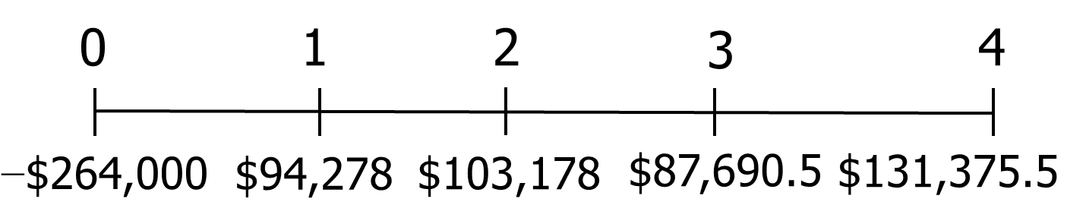
Project Net CFs Time Line
Enter CFs in CFLO register and I/YR = 10.
NPV = $62,593.
IRR = 20.1%.

Slide 27
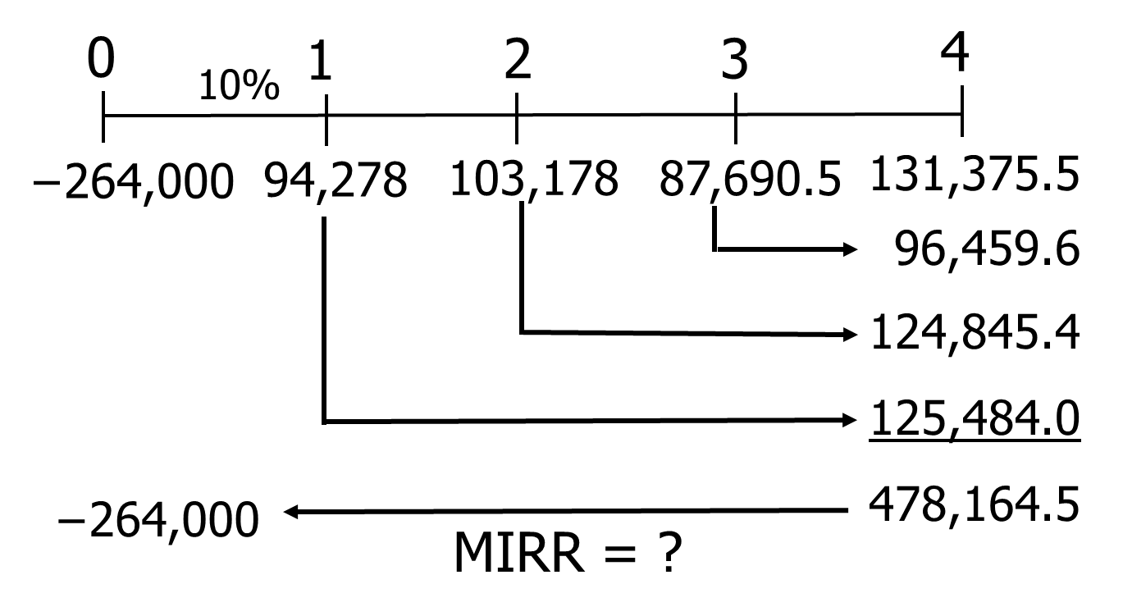
What is the project’s MIRR?

Slide 28
Calculator Solution
Enter positive CFs in CFLO. Enter I/YR = 10. Solve for NPV = 326,592.77.
Now use TVM keys: PV = -326,592.77, N = 4, I/YR = 10; PMT = 0; Solve for FV = 478,164.47. (This is TV of inflows)
Use TVM keys: N = 4; FV = 478,164.47; PV = -264,000; PMT= 0; Solve for I/YR = 16.0%.
MIRR = 16.0%.

Slide 29
Profitability Index (PI)
PI = PV of future CF / Initial CF
PI = $326,592.77/$264,000
PI = 1.24.

Slide 30
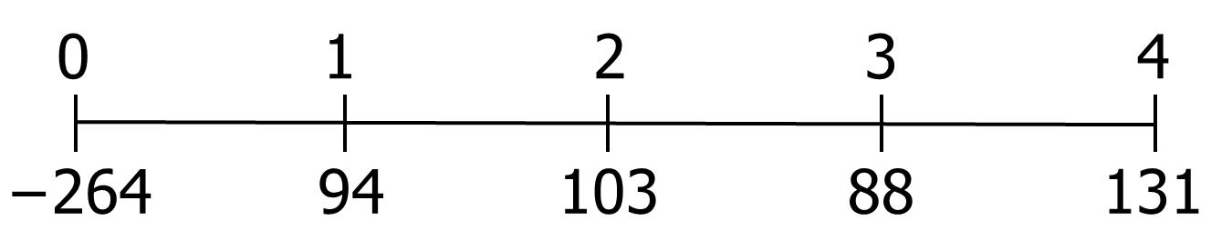
What is the project’s payback? ($ thousands)
Cumulative:
−264 −170 −67 21 152
Payback = 2 + $67/$88 = 2.8 years.

Slide 31
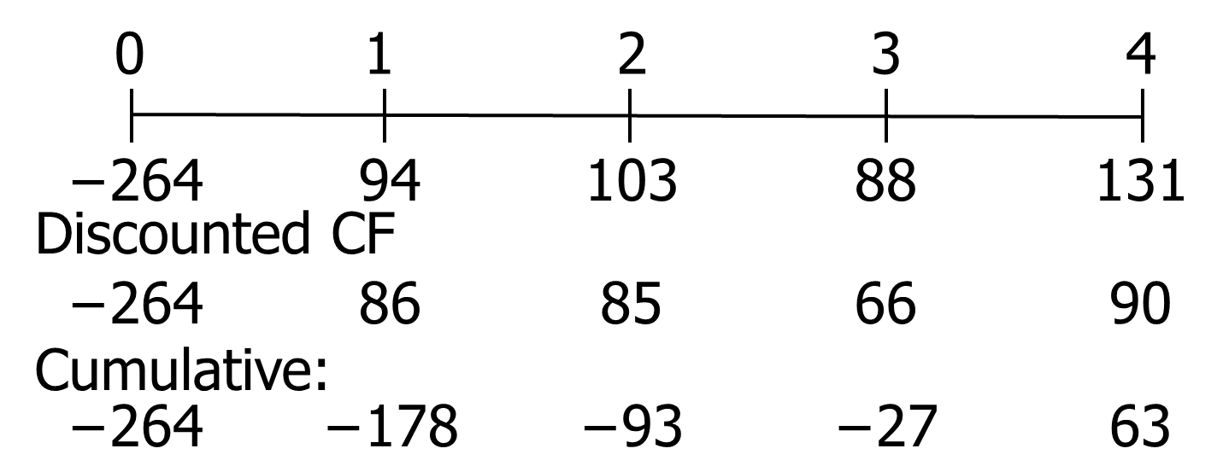
What is the project’s discounted payback? ($ thousands)
Payback = 3 + $27/$90 = 3.3 years.

Slide 32
What does “risk” mean in capital budgeting?
Uncertainty about a project’s future profitability.
Measured by σ_{NPV}, σ_{IRR}, beta.
Will taking on the project increase the firm’s and stockholders’ risk?

Slide 33
Is risk analysis based on historical data or subjective judgment?
Can sometimes use historical data, but generally cannot.
So risk analysis in capital budgeting is usually based on subjective judgments.

Slide 34
What three types of risk are relevant in capital budgeting?
Stand-alone risk
Corporate risk
Market (or beta) risk

Slide 35
Stand-Alone Risk
The project’s risk if it were the firm’s only asset and there were no shareholders.
Ignores both firm and shareholder diversification.
Measured by the σ or CV of NPV, IRR, or MIRR.

Slide 36
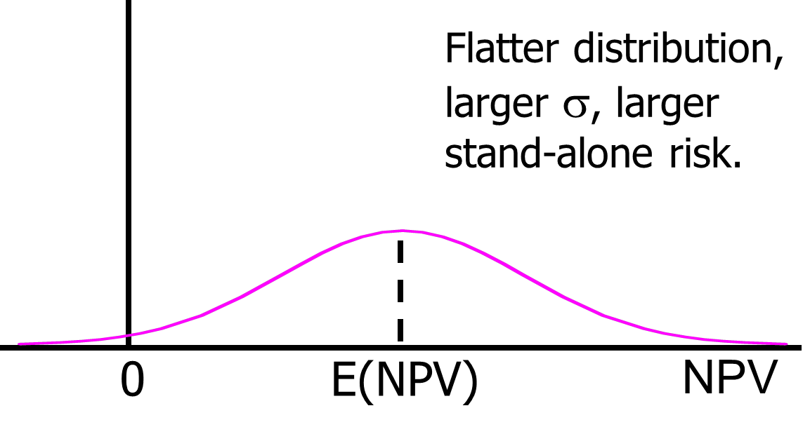
Probability Density

Slide 37
Corporate Risk
Reflects the project’s effect on corporate earnings stability.
Considers firm’s other assets (diversification within firm).
Depends on project’s σ, and its correlation, ρ, with returns on firm’s other assets.
Measured by the project’s corporate beta.

Slide 38
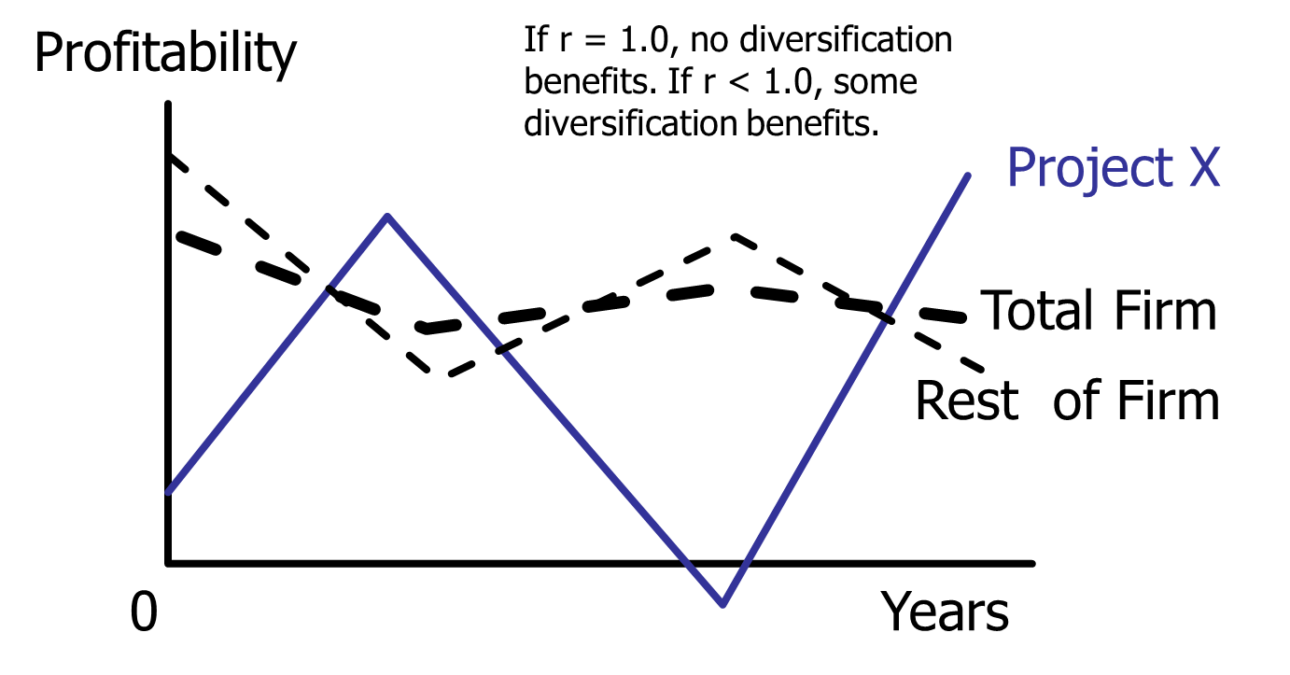
Project X is negatively correlated to firm’s other assets, so has big diversification benefits

Slide 39
Market Risk
Reflects the project’s effect on a well-diversified stock portfolio.
Takes account of stockholders’ other assets.
Depends on project’s σ and correlation with the stock market.
Measured by the project’s market beta.

Slide 40
How is each type of risk used? (1 of 2)
Market risk is theoretically best in most situations.
However, creditors, customers, suppliers, and employees are more affected by corporate risk.
Therefore, corporate risk is also relevant.

Slide 41
How is each type of risk used? (2 of 2)
Stand-alone risk is easiest to measure, more intuitive.
Core projects are highly correlated with other assets, so stand-alone risk generally reflects corporate risk.
If the project is highly correlated with the economy, stand-alone risk also reflects market risk.

Slide 42
What is sensitivity analysis?
Shows how changes in a variable such as unit sales affect NPV or IRR.
Each variable is fixed except one. Change this one variable to see the effect on NPV or IRR.
Answers “what if” questions, e.g. “What if sales decline by 30%?”

Slide 43
Sensitivity Analysis: NPV for Input Deviations from Base Case
Dev. From Base | NPV: Unit Cost Dev. | NPV: Unit Sales Dev. | NPV: Salvage Dev.
-30% | $136,927 | -$9,363 | $58,751
-15% | $99,760 | $26,615 | $60,672
0% | $62,593 | $62,593 | $62,593
15% | $25,426 | $98,571 | $64,514
30% | -$11,742 | $134,548 | $66,435

Slide 44
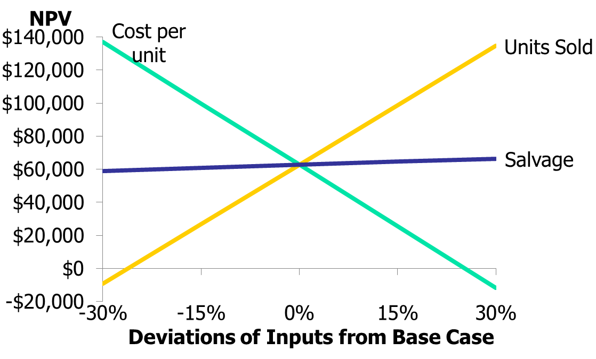
Sensitivity Graph: NPV for Input Deviations from Base Case

Slide 45
Results of Sensitivity Analysis
Steeper sensitivity lines show greater risk. Small changes result in large declines in NPV.
The cost line per unit line is steepest.
Unit sales line is also steep, but not as steep as the cost per unit line.
Salvage line is flat.
Managers should focus on costs and sales demand.

Slide 46
What are the weaknesses of sensitivity analysis?
Does not reflect diversification.
Says nothing about the likelihood of change in a variable, i.e. a steep sales line is not a problem if sales won’t fall.
Ignores relationships among variables.

Slide 47
Why is sensitivity analysis useful?
Gives some idea of stand-alone risk.
Identifies dangerous variables.
Gives some breakeven information.

Slide 48
What is scenario analysis?
Examines several possible situations, usually worst case, most likely case, and best case.
Provides a range of possible outcomes.

Slide 49
Best scenario: 1,200 units @ $240 Worst scenario: 800 units @ $160
Scenario | Prob. | Unit Sales | Unit Price | NPV
Best Case | 25% | 1,200 | $240 | $227,595
Base Case | 50% | 1,000 | $200 | $62,593
Worst Case | 25% | 800 | $160 | -$63,399
Expected NPV = | $72,345
Standard Deviation = | 103,343
Coefficient of Var. = Std Dev / Exp. NPV = | 1.43

Slide 50
Are there any problems with scenario analysis?
Only considers a few possible out-comes.
Assumes that inputs are perfectly correlated—all “bad” values occur together and all “good” values occur together.
Focuses on stand-alone risk, although subjective adjustments can be made.

Slide 51
What is a simulation analysis? (1 of 2)
A computerized version of scenario analysis that uses continuous probability distributions.
Computer selects values for each variable based on given probability distributions.

Slide 52
What is a simulation analysis? (2 of 2)
NPV and IRR are calculated.
Process is repeated many times (1,000 or more).
End result: Probability distribution of NPV and IRR based on sample of simulated values.
Generally shown graphically.

Slide 53
Simulation Example Assumptions
Normal distribution for unit sales:
Mean = 1,000
Standard deviation = 200
Normal distribution for unit price:
Mean = $200
Standard deviation = $30

Slide 54
Simulation Process
Pick a random variable for unit sales and sale price.
Substitute these values in the spreadsheet and calculate NPV.
Repeat the process many times, saving the input variables (units and price) and the output (NPV).

Slide 55
Simulation Results for 2,000 trials. (See Ch11 Mini Case.xlsx, worksheet Monte Carlo Simulation for a simulation with 100 iterations.)
 | Price | Units | NPV
Mean | $199 | $999 | $60,641
Std deviation | 29 | 211 | $100,354
Maximum | $255 | $1,486 | $325,070
Minimum | $119 | $463 | -$142,758
Median |  |  | $64,974
Probability of NPV > 0 3.8%
Coefficient of variation 1.65

Slide 56
Interpreting the Results
Inputs are consistent with specified distributions.
Units: Mean = 1,252; St. Dev. = 199.
Price: Mean = $200; St. Dev. = $30.
Mean NPV = $88,808. Low probability of negative NPV (100% – 87% = 13%).

Slide 57
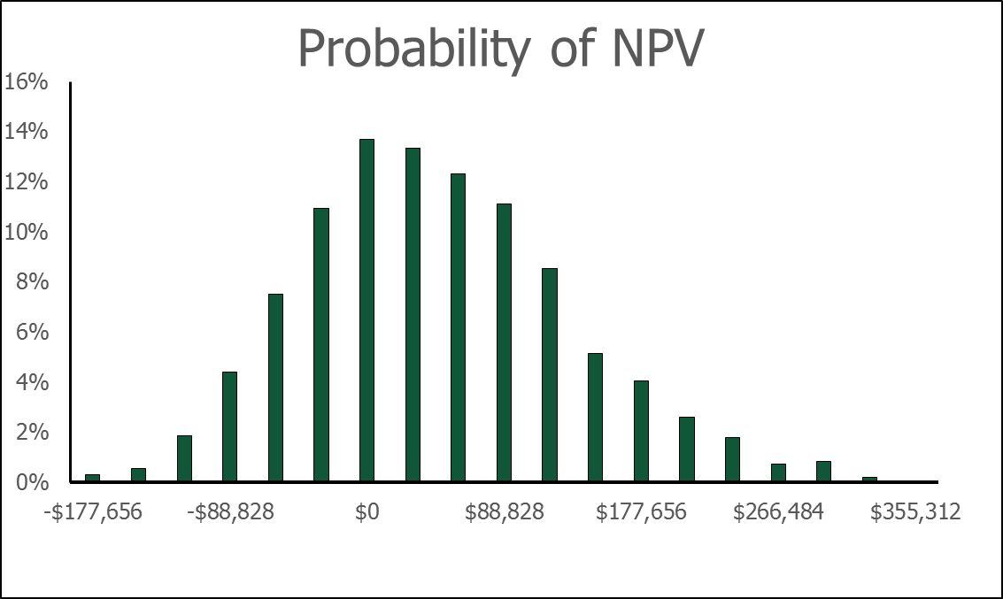
Histogram of Results

Slide 58
What are the advantages of simulation analysis?
Reflects the probability distributions of each input.
Shows range of NPVs, the expected NPV, σ_{NPV}, and CV_{NPV}.
Gives an intuitive graph of the risk situation.

Slide 59
What are the disadvantages of simulation? (1 of 2)
Difficult to specify probability distributions and correlations.
If inputs are bad, output will be bad: “Garbage in, garbage out.”

Slide 60
What are the disadvantages of simulation? (2 of 2)
Sensitivity, scenario, and simulation analyses do not provide a decision rule. They do not indicate whether a project’s expected return is sufficient to compensate for its risk.
Sensitivity, scenario, and simulation analyses all ignore diversification. Thus they measure only stand-alone risk, which may not be the most relevant risk in capital budgeting.

Slide 61
If the firm’s average project has a CV of 0.2 to 0.4, is this a high-risk project? What type of risk is being measured?
CV from scenarios = 1.43, CV from simulation = 1.65. Both are > 0.4, this project has high risk.
CV measures a project’s stand-alone risk.
High stand-alone risk usually indicates high corporate and market risks.

Slide 62
With a 3% risk adjustment, should our project be accepted?
Project r = 10% + 3% = 13%.
That’s 30% above base r.
NPV = $41,584.
Project remains acceptable after accounting for differential (higher) risk.

Slide 63
Should subjective risk factors be considered?
Yes. A numerical analysis may not capture all of the risk factors inherent in the project.
For example, if the project has the potential for bringing on harmful lawsuits, then it might be riskier than a standard analysis would indicate.

Slide 64
What is a real option?
Real options exist when managers can influence the size and risk of a project’s cash flows by taking different actions during the project’s life in response to changing market conditions.
Alert managers always look for real options in projects.
Smarter managers try to create real options.

Slide 65
What are some types of real options? (1 of 2)
Investment timing options
Growth options
Expansion of existing product line
New products
New geographic markets

Slide 66
Types of real options (Continued) (2 of 2)
Abandonment options
Contraction
Temporary suspension
Flexibility options

Slide 67
Bonus Depreciation in the 2017 Tax Cuts and Job Act (TCJA)
The TCJA has provisions for bonus depreciation.
Allows a company to take additional depreciation in the year that an asset is put in service.
Only applies to 2018-2026.

Slide 68
Bonus Depreciation Rates for First Year that Assets Are Placed in Service
Year | 2018 | 2019 | 2020 | 2021 | 2022
Rate | 100% | 100% | 100% | 100% | 100%
Year | 2023 | 2024 | 2025 | 2026 | 2027
Rate | 80% | 60% | 40% | 20% | 0%

Slide 69
Example 1: $100,000 asset in the 3-year class put in service in 2020
 | 2020 | 2021 | 2022 | 2023
Initial basis | $100,000
Bonus % depr. | 100%
Bonus depr. | $100,000
MACRS basis: | $0
MACRS % depr. | 33.33% | 44.45% | 14.81% | 7.41%
MACRS depr. | $0 | $0 | $0 | $0
Total depr. | $100,000 | $0 | $0 | $0

Slide 70
Example 2: $100,000 asset in the 3-year class put in service in 2023
 | 2020 | 2021 | 2022 | 2023
Initial basis | $100,000
Bonus % depr. | 80%
Bonus depr. | $80,000
MACRS basis: | $20,000
MACRS % depr. | 33.33% | 44.45% | 14.81% | 7.41%
MACRS depr. | $6,666 | $8,890 | $2,962 | $1,482
Total depr. | $86,666 | $8,890 | $2,962 | $1,482

